Slide 1
W-MIC study: Psychometric results

Slide 2
Agenda
Background and project aim
Methodology
Results
Discussion
Q&A

Slide 3

Let’s do a little quiz!
Go to
www.menti.com
Enter the code
6186 0425

Slide 4
Background and research aim

Slide 5
Background (1/2)
Economic evaluations (EE) advocated to be used in long-term care (LTC) and non-curative settings
Current outcome measures are inadequate given their focus on (physical) health
Extending applications of EE to LTC settings will require focusing on broader outcomes, such as well-being

Slide 6
Background (2/2)
Several well-being questionnaires have been developed to use in non-curative care to evaluate technology and services
These questionnaires are at different stages of development and have never been compared altogether in the same context/population
It is still unclear which instruments should be used to assess the effectiveness of an intervention targeting well-being in a specific context
This question led to the project named “The Well-being Multi-Instrument Comparison” (W-MIC) study

Slide 7
Conceptual Coverage
Instrument | Mental health | Physical health | Cognitive health | Relationships | Support | Living environment | Safety | Finance | Relaxation and leisure | Activities | Acceptance and resilience | Independence | Self-worth | Personal hygiene | Life enjoyment / satisfaction | Quality of care | Thinking of future
EQ-HWB | x | x | x | x |  |  |  |  |  | x |  | x
WiX | x | x |  | x | ~ | x | x | x | x | x | ~ | x | x
WOOP | x | x | ~ | x | x | x |  | x |  | ~ | x | x | x
SWB-5D | x | ~ |  | x |  |  |  |  |  | ~ | ~ | x
ASCOT |  |  |  | x |  | x | x |  | ~ | x |  | x | x | x |  | ~
QOL-ACC | x | x |  | x |  |  |  |  | x |  |  | x
ICECAP-A |  |  |  | x | x |  | x |  |  |  |  | x | ~ |  | x
ICECAP-O |  |  |  | x |  |  |  |  | x | ~ |  | x | x |  |  |  | x
x indicates full coverage
~ indicates partial coverage
Notes:
This slides provide an overview of the conceptual coverage across all instruments (well-being measures, disease-specific measures and generic health and well-being questionnaires).
As it can be seen, the survey will cover a wide range of aspects, with particular attention to mental health and physical health as well as other broader aspects of well-being such as their relationship, activities and independence.
Other less commonly covered aspects will also be investigated, such as their feelings of personal safety and finance satisfaction.
The x indicates full coverage, meaning that the items in the questionnaire directly enquire about that specific aspect. The cells in yellow indicate partial coverage, meaning that they do not fully address that aspect or only touches upon it broadly.
An example is an item from the SWB-5D which asks about whether their health restricts their physical activities. This is not directly asking about their physical health nor about their ability to engage in all types of activities (but rather only physical ones), therefore this is why it was categorized as partial coverage.

Slide 8
Research aims
1. Contribute to the further validation and development of multiple well-being instruments intended for economic evaluations
2. Develop a large, openly available dataset on health and well-being to be leveraged by other interested researchers

Slide 9
Methodology

Slide 10
Methodology
Cross-sectional survey with follow-up measurement
7000 US and NL participants, with quotas for specific subgroups (general, older, targeted health conditions)
Dynata hosted and recruited participants
Demographics (Module A), Well-being instruments (Module B), Clinical severity (Module C), General health (Module D), General well-being (Module E)
Study design
Population
Measures
Data collection

Slide 11
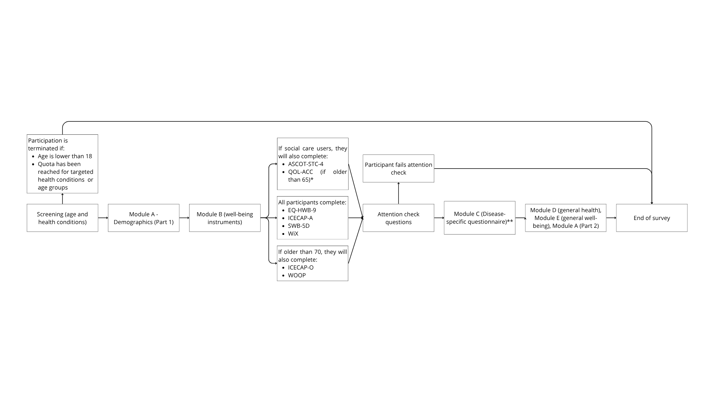
Survey logic

Slide 12
In-survey quality checks
Attention check questions
Dynata’s quality check, including:
reCAPTCHAs,
Geo-IP tracking,
Address verification,
Digital fingerprinting,
IP deduplication
Dynata’s QualityScore:
<20 automatically excluded
21-50 manually checked by Dynata

Slide 13
Post-hoc data quality checks
Post-hoc data quality checks:
Criteria 1: Inconsistent pain reporting: EQ-HWB-9 (Q4) vs. EQ-5D-5L (Q83)
Criteria 2: Inconsistent daily activity reporting: EQ-HWB-9 (Q3) vs. EQ-5D-5L (Q82)
Criteria 3: Inconsistent financial situation: WiX (Q10) vs. ability to make ends meet (Q103)
Criteria 4: Child count inconsistency: More children <18 (Q99) than total children (Q98)
Criteria 5: Completion time <5 minutes
Criteria 6: Survey quality score <90
Criteria 7: >5 self-reported health conditions
Participants meeting ≥3 criteria were removed
Participants excluded if provided extreme inconsistencies in Criteria 1 and 2 (>2 Likert points) or in Criteria 3 (e.g., very satisfied but much difficulty)

Slide 14
Statistical analysis
Ceiling/floor effects
Convergent validity
Known-groups validity
Test-retest reliability
To facilitate comparison between instruments with different scoring systems, level sum scores were linearly transformed to a standardized 0–100 scale.

Slide 15
Results

Slide 16
Quality checks
7838 participants completed the survey (US: n=4045, 52%; NL: n=3793, 48%)
5336 (68%) failed at least one criteria
683 (9%) were excluded
560 failed ≥3 criteria
202 provided extremely different answers

Slide 17
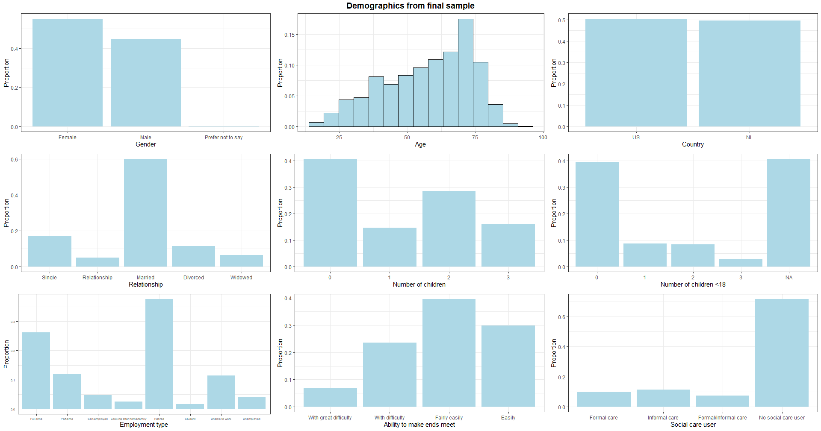
Demographics
7155 final sample (US: n= 3606, 50%; NL: n=3549, 50%)
Notes:
Mean age is 58 years (SD=16)

Slide 18
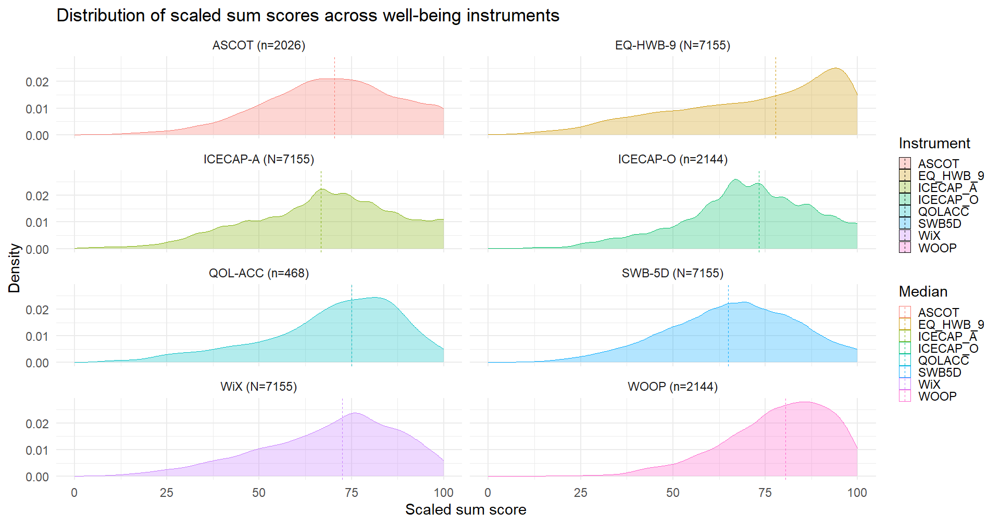
Descriptive statistics
Participants had moderate to high levels of well-being across instruments
More negatively skewed in the EQ-HWB-9 and WOOP

Slide 19
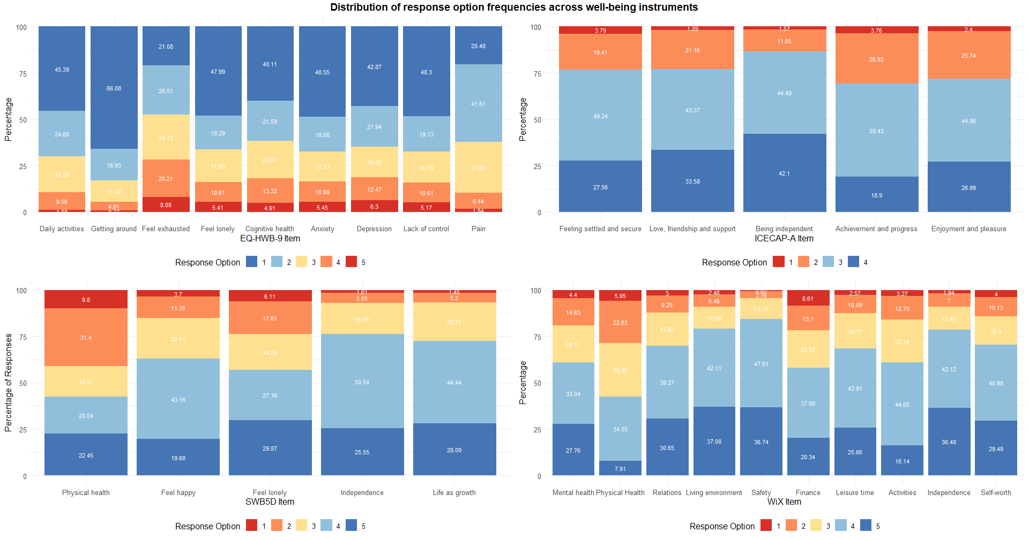
Response options frequencies - Main

Slide 20
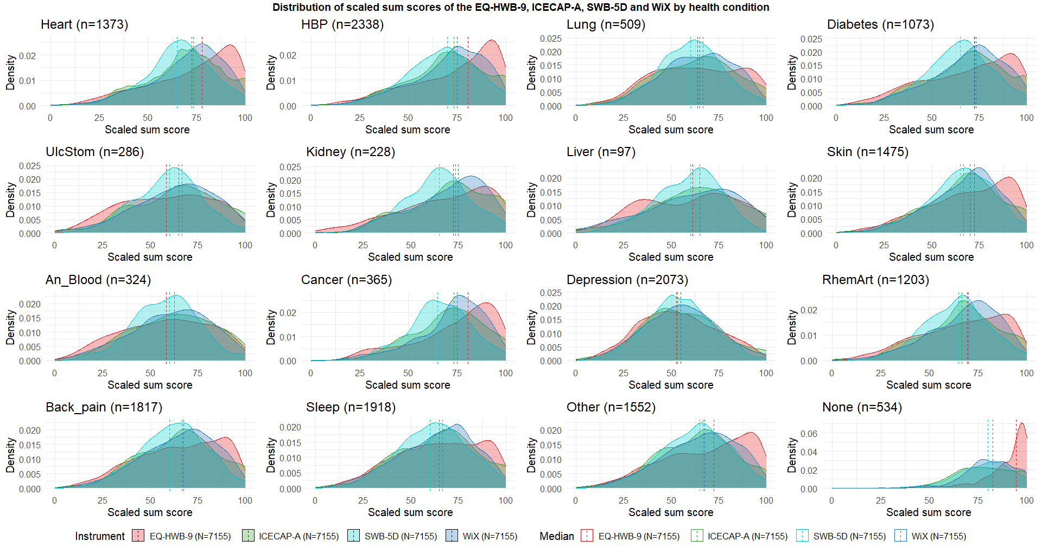
Descriptive statistics – Health conditions

Slide 21
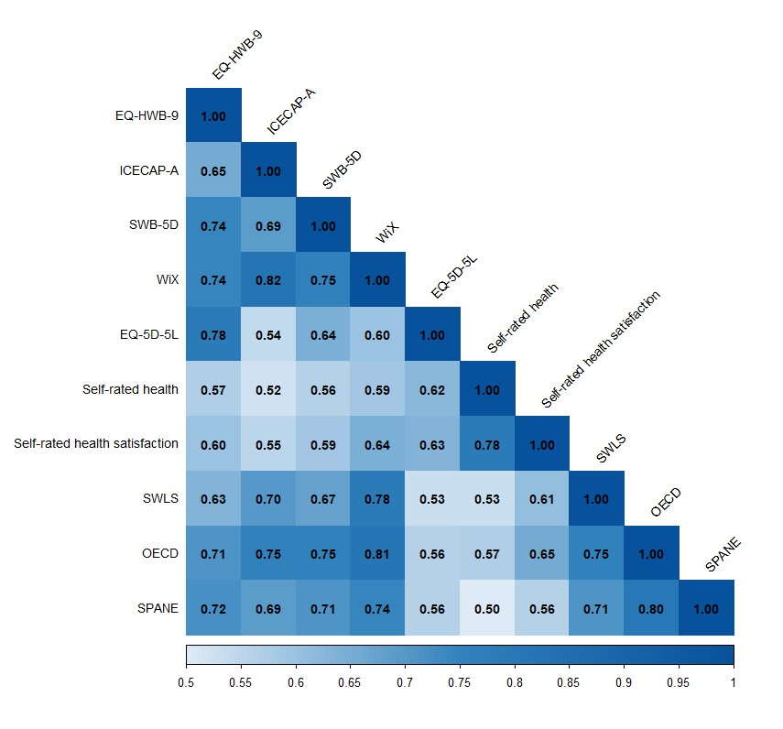
Convergent validity
All well-being instruments showed strong correlations among them
EQ-HWB-9 was more strongly correlated with EQ-5D-5L
WiX was more strongly correlated with ICECAP-A and general well-being questionnaires
Notes:
Adjust the reliability

Slide 22
Known-group validity
All well-being instruments were able to distinguish between clinical groups
EQ-HWB-9 and SWB-5D did not detect differences among social care users in post-hoc comparison using Bonferroni correction
Group | EQ-HWB-9 | ICECAP-A | SWB-5D | WiX
Depression
Clinical (n=634) – Mean (SD) | 45.01 (15.26) | 48.23 (17.84) | 47.71 (14.24) | 47.97 (16.52)
Non-clinical (n=412) – Mean (SD) | 72.26 (14.71) | 66.31 (17.30) | 65.36 (14.03) | 67.28 (14.23)
Mann-Whitney U results – U (p) [r] | 27533 (<0.001) [0.67] | 60313 (<0.001) [0.46] | 49571.5 (<0.001) [0.53] | 47054 (<0.001) [0.54]
Arthritis
High severity (n=579) – Mean (SD) | 55.72 (19.17) | 59.56 (19.39) | 56.60 (14.14) | 61.03 (18.14)
Moderate severity-Near remission (n=499) – Mean (SD) | 81.17 (14.10) | 75.55 (15.15) | 72.89 (13.68) | 77.05 (13.60)
Mann-Whitney U results – U (p) [r] | 40786.5 (<0.001) [0.62] | 74783.5 (<0.001) (0.42) | 59137 (<0.001) [0.51] | 67287 (<0.001) [0.46]
Sleep
High sleep disturbance (n=505) – Mean (SD) | 56.89 (20.33) | 56.92 (19.91) | 56.78 (17.11) | 56.68 (18.88)
Low sleep disturbance (n=571) – Mean (SD) | 75.58 (19.02) | 70.99 (19.12) | 68.99 (16.72) | 71.35 (17.04)
Mann-Whitney U results – U (p) [r] | 71801.5 (<0.001) [0.43] | 87189.5 (<0.001) [0.34] | 87060.5 (<0.001) [0.34] | 79889 (<0.001) (0.39)
Skin
Moderate to Extreme effect on life (n=408) – Mean (SD) | 60.59 (21.61) | 63.94 (20.29) | 61.99 (16.69) | 62.34 (19.52)
Small-no effect on life (n=673) – Mean (SD) | 77.96 (17.35) | 70.69 (17.93) | 70.25 (16.11) | 71.14 (16.07)
Mann-Whitney U results – U (p) [r] | 72485 (<0.001) [0.40] | 110711.5 (<0.001) [0.16] | 97203.5 (<0.001) [0.25] | 100264.5 (<0.001) (0.23)
Heart
High physical impact (n=561) – Mean (SD) | 61.51 (19.59) | 61.16 (18.98) | 57.09 (15.30) | 61.88 (17.85)
Low physical impact (n=547) – Mean (SD) | 88.27 (11.04) | 78.99 (13.91) | 75.75 (12.33) | 80.54 (12.11)
Mann-Whitney U results – U (p) [r] | 31012.5 (<0.001) [0.69] | 70275 (<0.001) (0.47) | 51867.5 (<0.001) [0.58] | 57110 (<0.001) [0.54]
General Health
Poor health (n=4501) – Mean (SD) | 63.74 (21.32) | 61.02 (19.45) | 59.39 (16.41) | 61.74 (18.41)
Good health (n=2654) – Mean (SD) | 86.02 (15.20) | 79.33 (14.95) | 77.22 (13.77) | 81.15 (12.36)
Mann-Whitney U results – U (p) [r] | 9757852 (<0.001) (0.53) | 9182292 (<0.001) [0.45] | 9521704 (<0.001) [0.50] | 9693975 (<0.01) [0.52]
Receiving care
Formal care users (n=700) | 57.37 (22.99) | 63.27 (22.58) | 58.01 (17.30) | 63.88 (21.01)
Formal and informal care users (n=519) | 57.65 (21.51) | 61.93 (20.99) | 58.90 (16.65) | 62.42 (19.96)
Informal care users (n=807) | 57.24 (19.97) | 59.45 (18.80) | 57.41 (16.32) | 60.67 (18.29)
Non care recipient (n=5129) | 77.78 (19.51) | 70.35 (19.07) | 69.16 (17.08) | 71.59 (17.90)
Kruskal-Wallis results – H (p) [η²] | 1224.045 (<0.001) [0.17] | 318.5162 (<0.001) [0.04] | 612.6007 (<0.001) [0.09] | 375.3747 (<0.001) [0.05]
Effect size interpretation: small (0.01 ≤ η² < 0.06, 0.1 ≤ r < 0.24); moderate (.06 ≤ η² < 0.14, 0.24 ≤ r < 0.37); strong (η²≥ 0.14, r ≥ 0.37)
Notes:
Formal care ->

Slide 23
Test-retest reliability
All well-being instruments showed reliable assessment over time (ICC>0.70)
Instrument | Correlations main and retest sample | Complete agreement | ICC (95% CI)
No change in health (n=790)
EQ-HWB-9 | 0.84 | 20.00% | 0.84 (0.82-0.86)
ICECAP-A | 0.74 | 24.94% | 0.75 (0.72-0.78)
SWB-5D | 0.74 | 21.52% | 0.76 (0.73-0.79)
WiX | 0.83 | 13.80% | 0.83 (0.80-0.85)
No change in well-being (n=752)
EQ-HWB-9 | 0.83 | 20.61% | 0.83 (0.80-0.85)
ICECAP-A | 0.72 | 25.13% | 0.74 (0.71-0.77)
SWB-5D | 0.73 | 21.81% | 0.75 (0.72–0.78)
WiX | 0.82 | 13.96% | 0.83 (0.80-0.85)

Slide 24
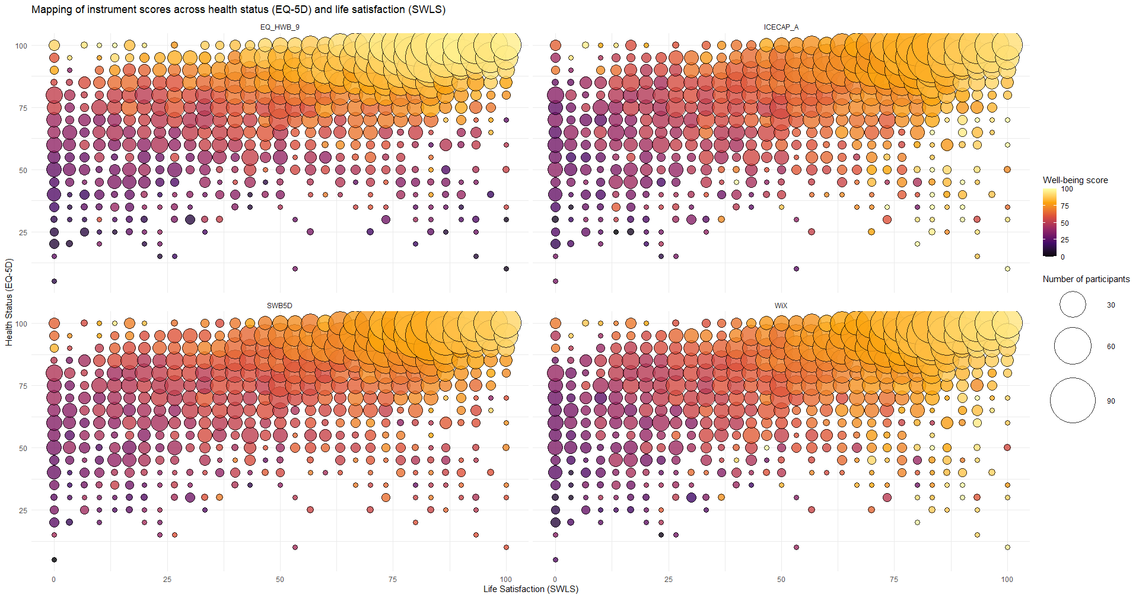
Instrument mapping

Slide 25
Discussion

Slide 26
Main findings
All instruments demonstrated good psychometric performance (particularly the WiX and EQ-HWB-9)
EQ-HWB-9 and SWB-5D seemed more sensitive to variations in health
ICECAP-A and WiX had higher sensitivity in broader well-being domains
Notes:
EQ-HWB-9 and SWB-6D: lower scores in conditions impacting physical health and stronger effect sizes in targeted health conditions
ICECAP-A and WiX: lower scores in individuals with no health conditions and significant differences between different types of social care users

Slide 27
Where would these differences come from?
They may be a consequence of the conceptual foundation of these instruments
EQ-HWB
Based on Wilson and Cleary’s model of health-related quality of life
Items generated following qualitative review focused on health conditions (5)
SWB-5D
Originated from Delphi study with overarching theme: “most important dimensions of health-related quality of life” (6)
ICECAP-A
Items identified with scoping review of existing well-being instruments
Selected based on theoretical framework of eleven broad domains of well-being (8)
WiX
Based on capability approach
Items generated in interviews exploring what is important to individuals in their life (7)
Brazier J, Peasgood T, Mukuria C, Marten O, Kreimeier S, Luo N, et al. The EQ-HWB: Overview of the Development of a Measure of Health and Wellbeing and Key Results. Value Health. 2022 Apr 1;25(4):482–91.
Pietersma S, De Vries M, Van Den Akker-van Marle ME. Domains of quality of life: results of a three-stage Delphi consensus procedure among patients, family of patients, clinicians, scientists and the general public. Qual Life Res
Al-Janabi H, Flynn TN, Coast J. Development of a self-report measure of capability wellbeing for adults: the ICECAP-A. Qual Life Res Int J Qual Life Asp Treat Care Rehabil. 2012 Feb;21(1):167–76.
Voormolen DC, Bom JAM, de Bekker-Grob EW, Brouwer WBF, van Exel J. Development and Content Validation of the 10-item Well-being Instrument (WiX) for use in Economic Evaluation Studies. Appl Res Qual Life. 2024 Apr 1;19(2):381–413.

Slide 28
Next steps
Do these instruments have similar well-being conceptualization? How do their items load on different well-being concepts?
Are there specific subgroups in the population that respond with similar patterns?

Slide 29
Collaborations between ESSB and ESHPM?
Are there possible collaborations between our two departments?
Research project?
Data will be soon made open-access and can be exploited for secondary research questions
Joint symposium?
EcoEchoes podcast?
ESHPM Multi-Juse?
Other ideas?

Slide 30
Appendix

Slide 31
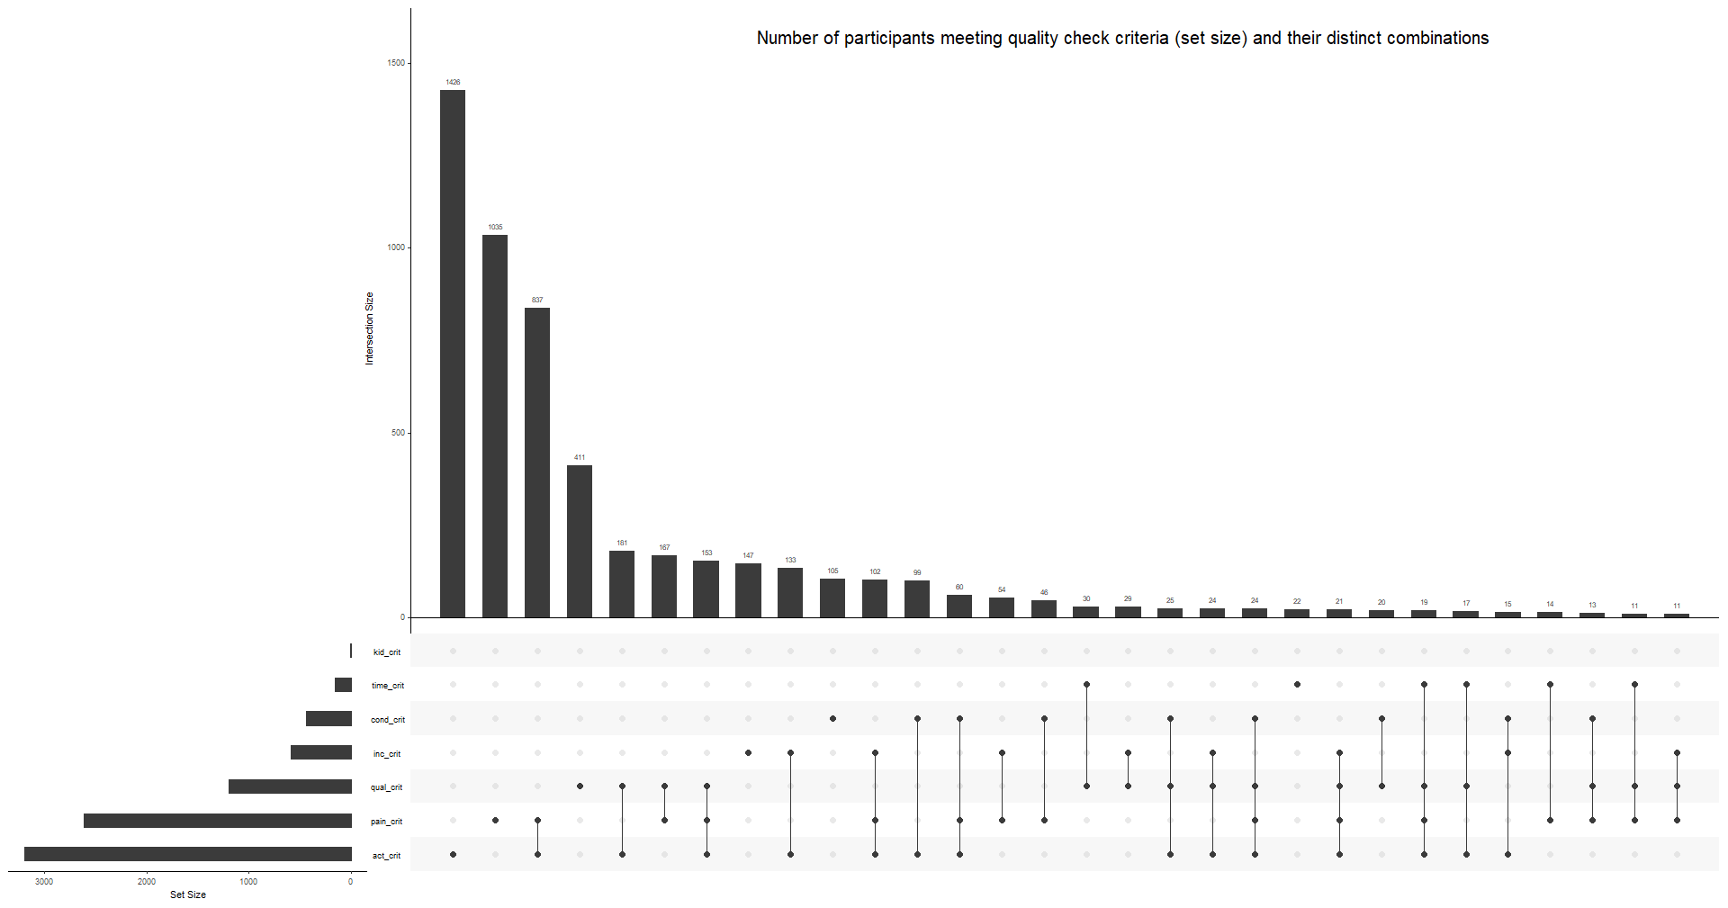
Quality checks

Slide 32
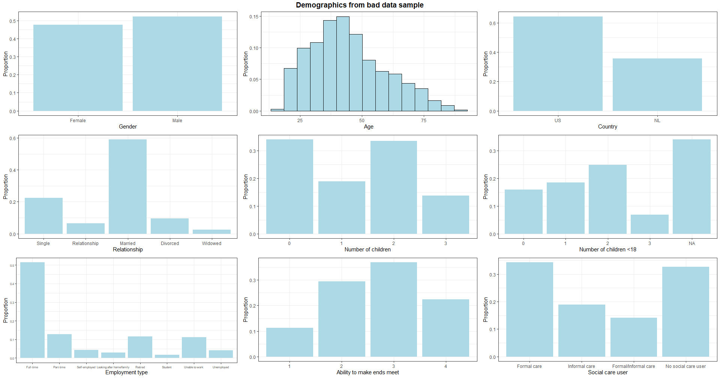
Demographics – Bad data sample

Slide 33
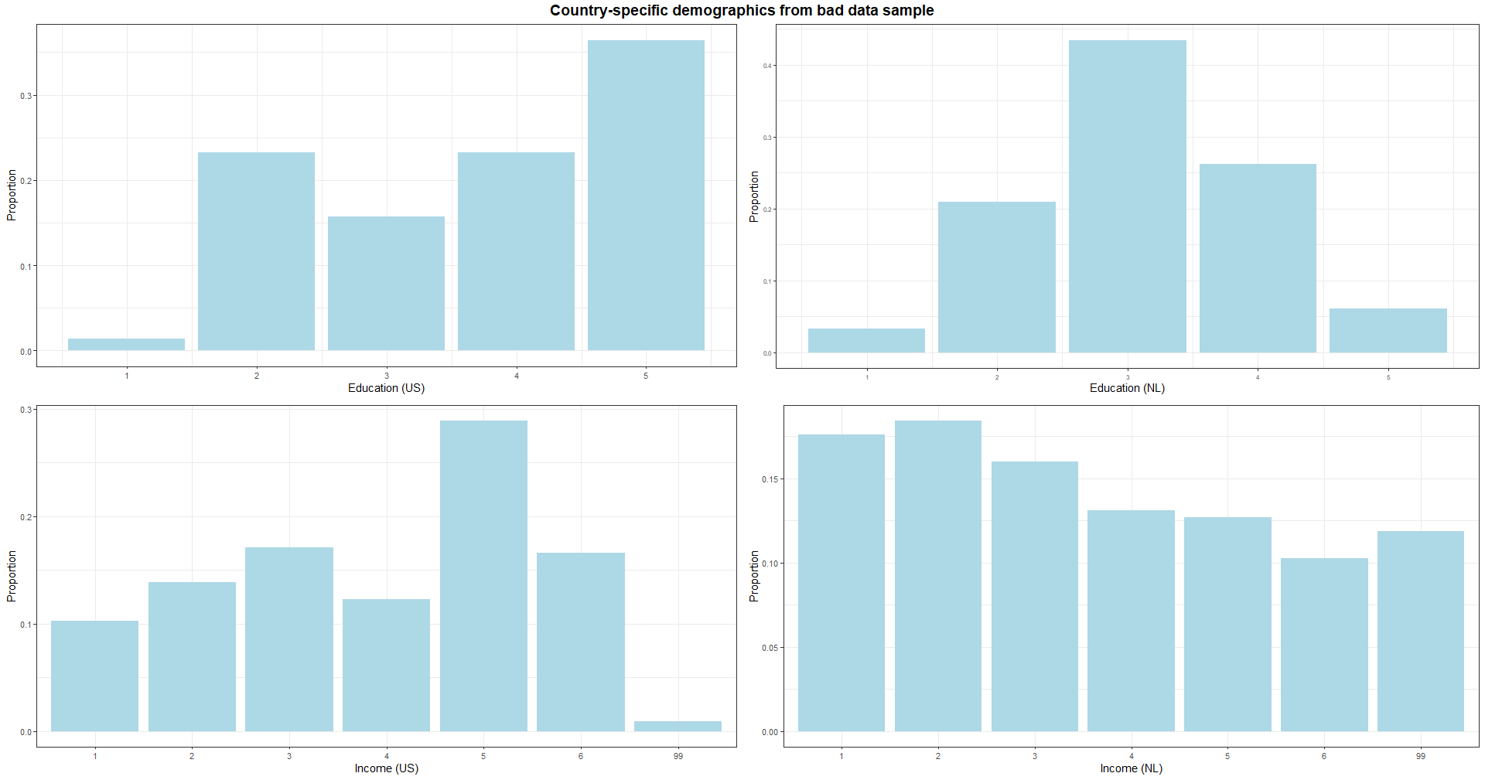
Demographics – Country-specific (bad data)

Slide 34
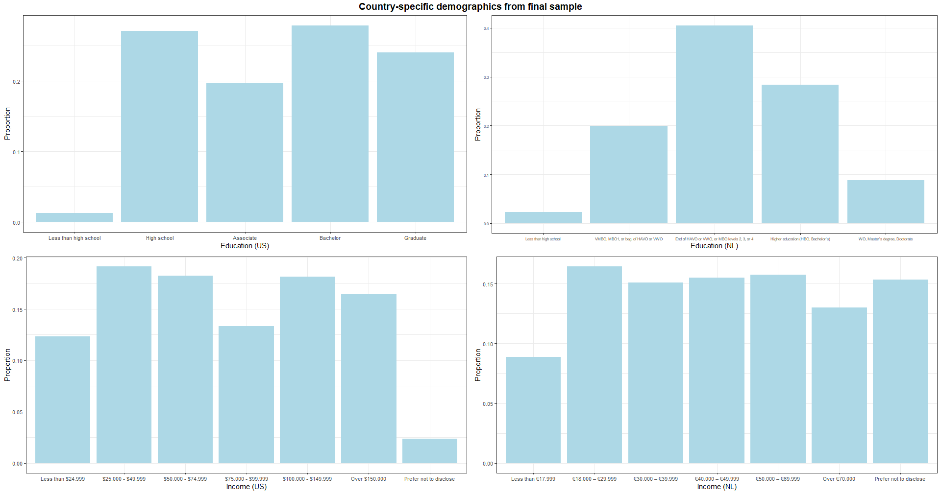
Demographics – Country-specific
7155 final sample (US: n= 3606, 50%; NL: n=3549, 50%)

Slide 35
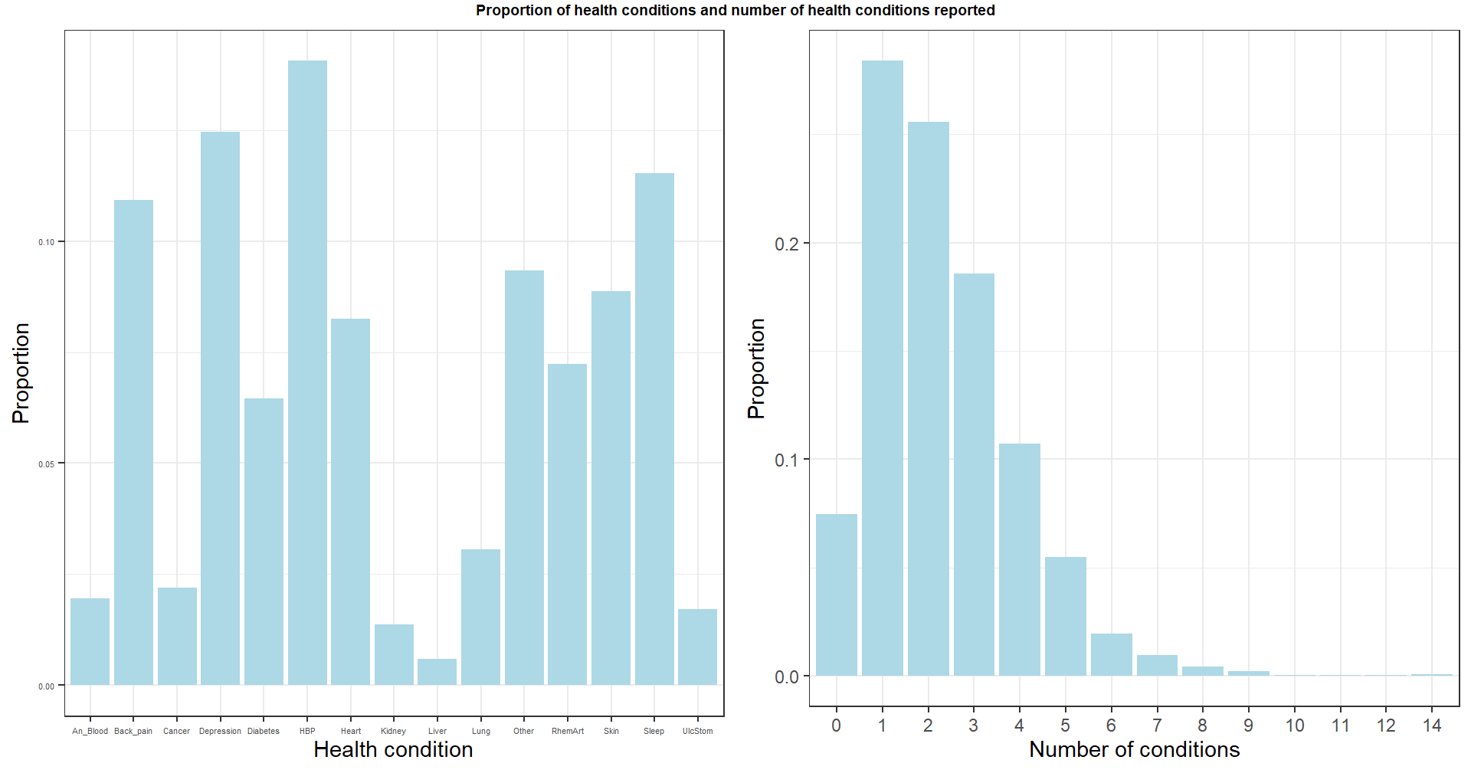
Health conditions

Slide 36
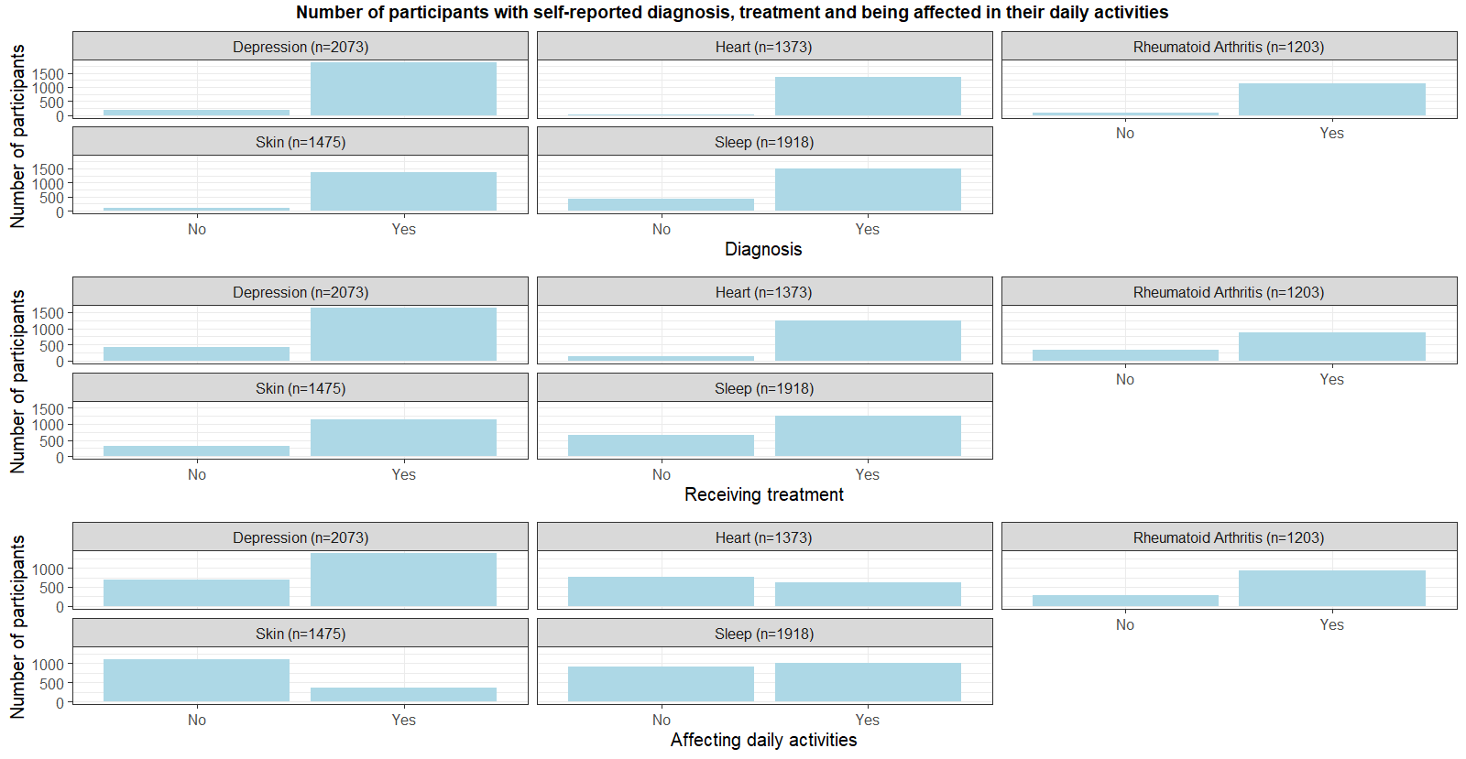
Targeted health conditions

Slide 37
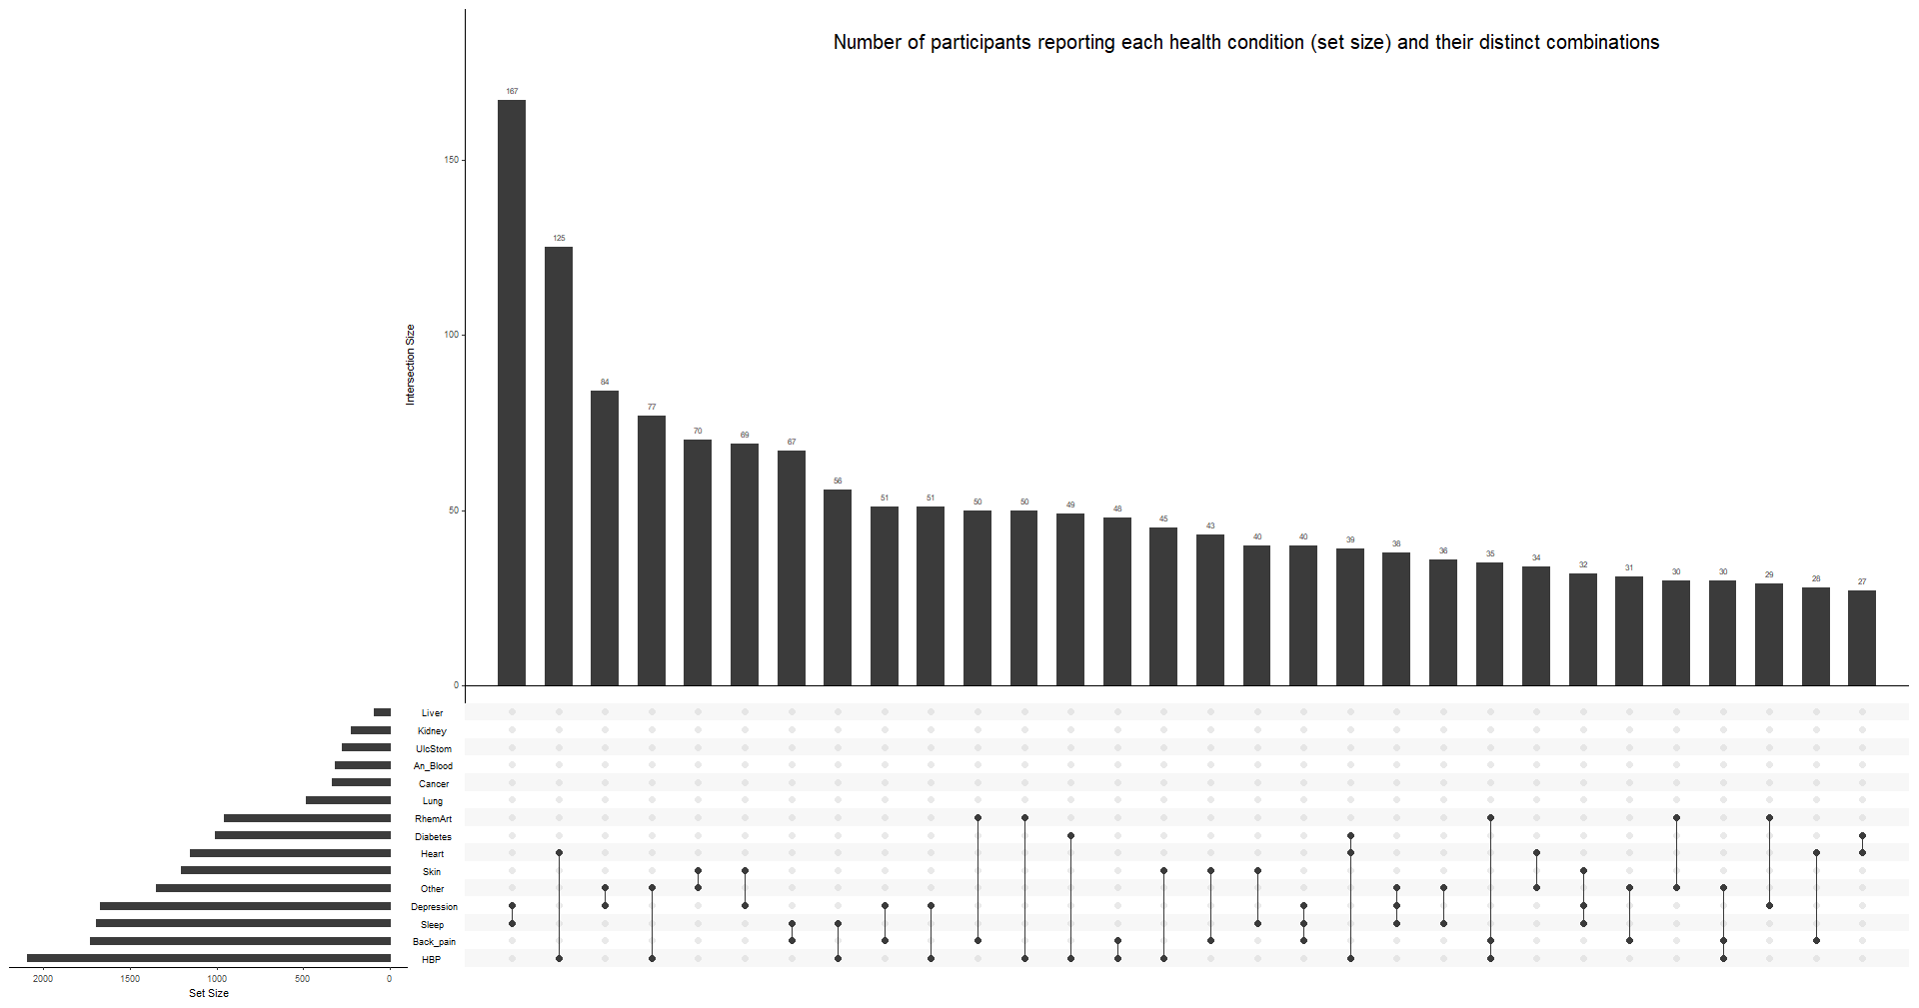
Comorbidity

Slide 38
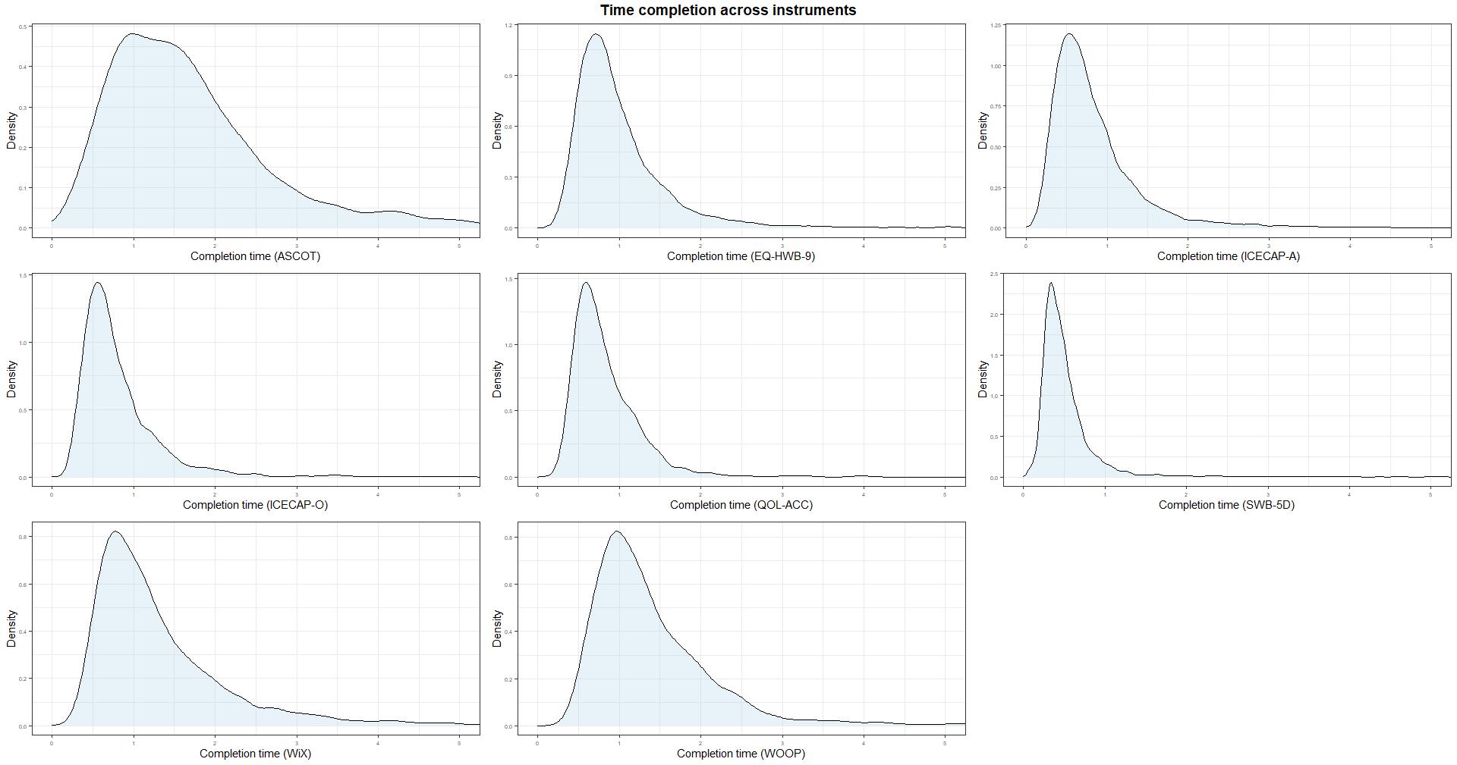
Completion time

Slide 39
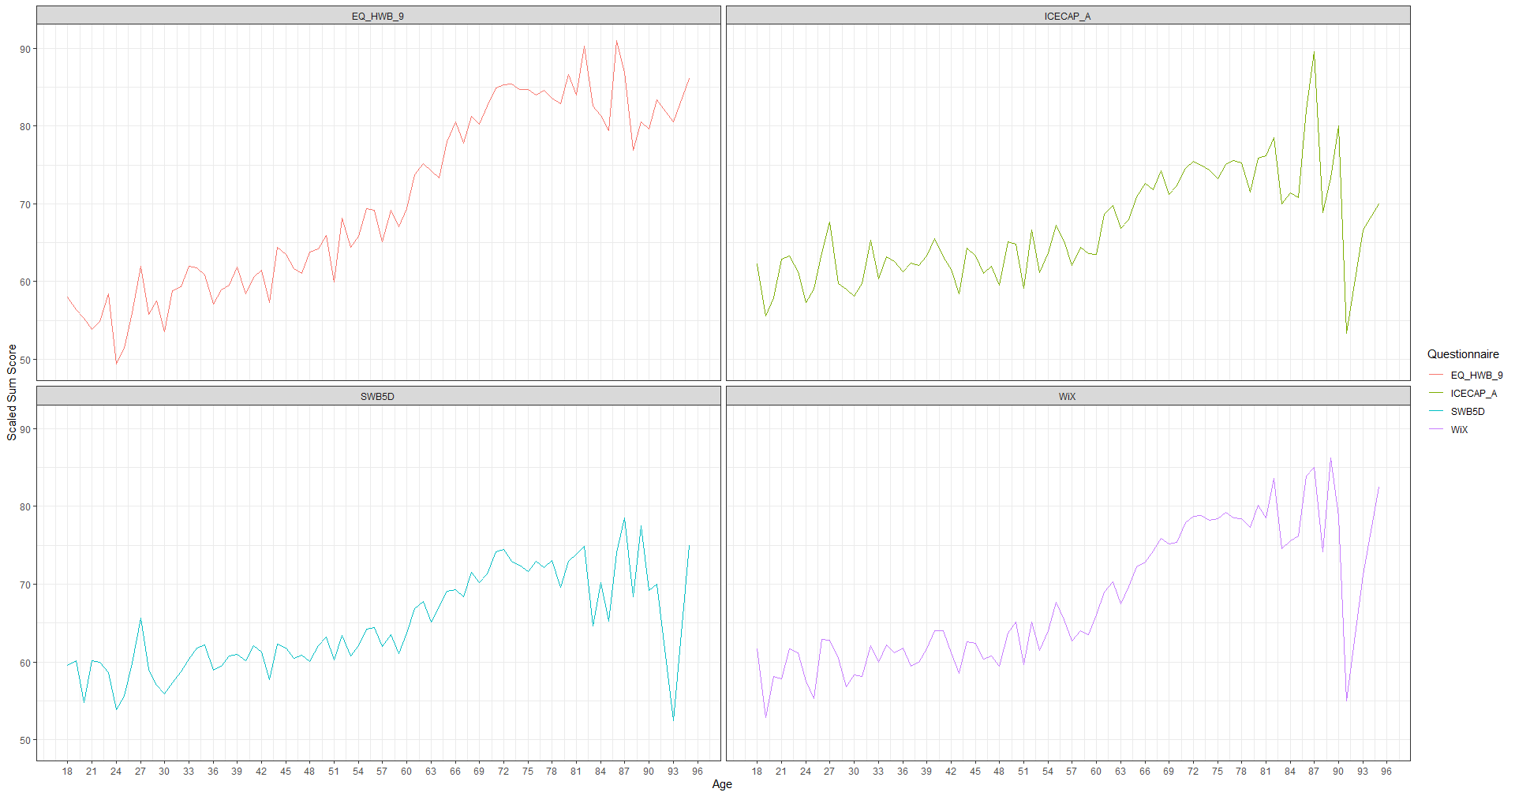
Descriptive statistics – Scores by age

Slide 40
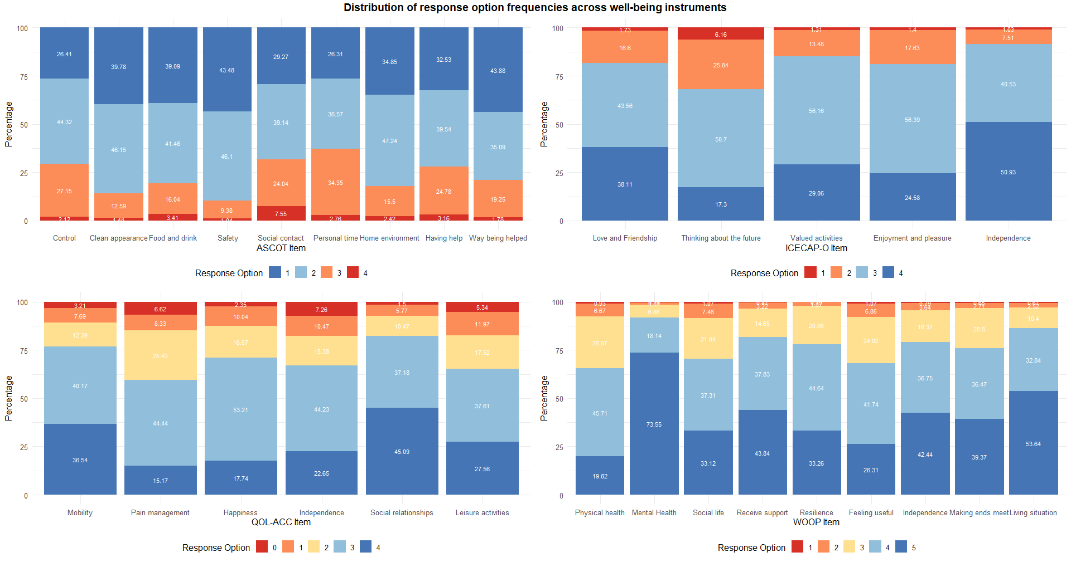
Response options frequencies - Other

Slide 41
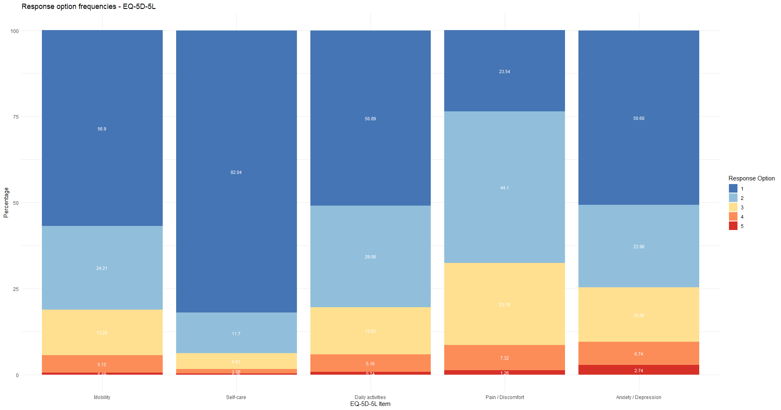
Response options frequencies – EQ-5D

Slide 42
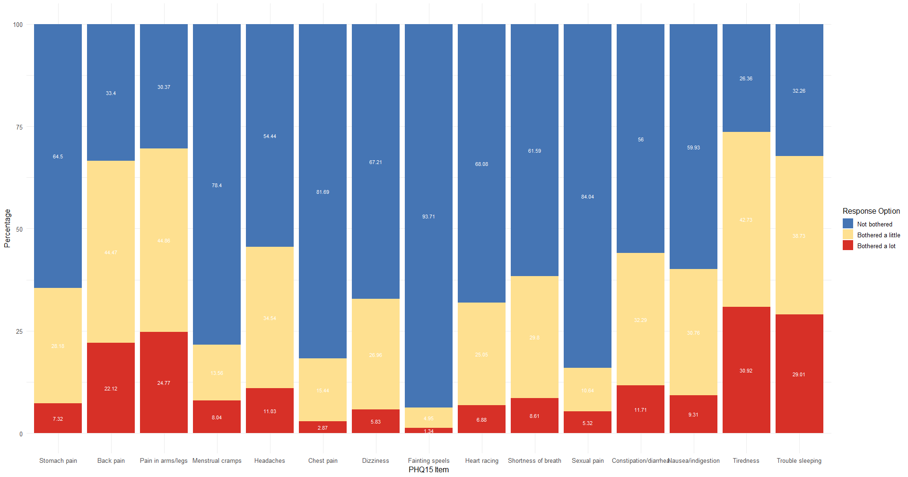
Response options frequencies – PHQ-15

Slide 43
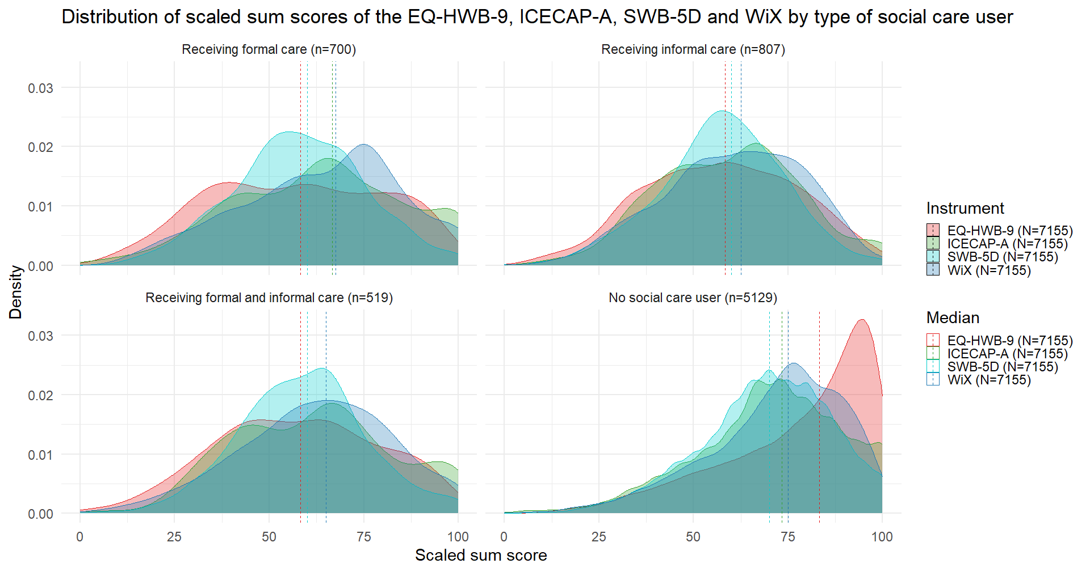
Descriptive statistics – Social care users

Slide 44
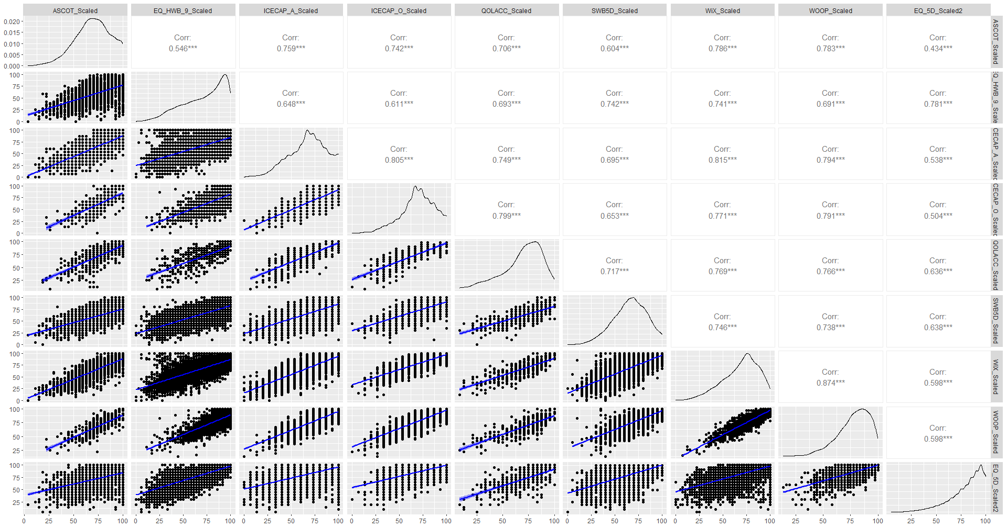
Convergent validity – All instruments

Slide 45
Known-group validity
All well-being instruments were able to distinguish between demographics groups, to a lower extent
Group | EQ-HWB-9 | ICECAP-A | SWB-5D | WiX
Age
18-24 (n=207) – Mean (SD) | 54.82 (20.68) | 60.06 (18.83) | 58.04 (17.92) | 58.71 (17.77)
25-34 (n=575) – Mean (SD) | 58.13 (21.67) | 61.52 (21.27) | 59.12 (18.17) | 59.90 (19.84)
35-44 (n=937) – Mean (SD) | 60.16 (21.80) | 62.61 (21.15) | 60.64 (17.22) | 61.54 (20.18)
45-54 (n=1057) – Mean (SD) | 64.02 (22.32) | 62.72 (20.97) | 61.57 (17.34) | 62.37 (19.24)
55-69 (n=2235) – Mean (SD) | 73.99 (20.54) | 68.36 (19.14) | 66.56 (17.34) | 69.50 (17.80)
70+ (n=2144) – Mean (SD) | 84.44 (15.34) | 74.47 (17.26) | 72.57 (15.89) | 78.23 (14.28)
Kruskal-Wallis results – H (p) [η²] | 1525.026 (<0.001) [0.21] | 450.4962 (<0.001) [0.06] | 591.3893 (<0.001) [0.08] | 1011.029 (<0.001) [0.14]
Gender
Female (n=3944) | 68.94 (22.01) | 65.72 (20.02) | 64.60 (17.90) | 66.58 (18.98)
Male (n=3206) | 75.85 (21.50) | 70.45 (19.56) | 67.77 (17.30) | 71.89 (18.34)
Mann-Whitney U results – U (p) [r] | 5060303 (<0.001) [0.17] | 5422128 (<0.001) [0.12] | 5624552 (<0.001) [0.10] | 5213512 (<0.001) [0.15]
Income
Low (n=2035) | 63.32 (23.34) | 60.11 (21.40) | 60.41 (18.47) | 60.68 (20.32)
Medium (n=2223) | 73.52 (21.21) | 68.38 (19.05) | 66.55 (17.34) | 69.41 (18.04)
High (n=2267) | 77.34 (19.95) | 74.17 (17.64) | 70.38 (16.36) | 75.53 (16.30)
Kruskal-Wallis results – H (p) [η²] | 431.3689 (<0.001) [0.07] | 509.4986 (<0.001) [0.08] | 331.9955 (<0.001) [0.05] | 630.9963 (<0.001) [0.10]
Education
Lower (n=1814) | 67.23 (23.66) | 63.00 (21.62) | 62.33 (18.09) | 64.40 (20.09)
Middle (n=2150) | 71.22 (21.48) | 65.94 (19.13) | 64.71 (17.44) | 66.75 (18.22)
Higher (n=3191) | 75.25 (20.98) | 71.81 (18.75) | 68.96 (17.19) | 72.98 (17.83)
Kruskal-Wallis results – H (p) [η²] | 147.6623 (<0.001) [0.02] | 250.6048 (<0.001) [0.03] | 177.7297 (<0.001) [0.02] | 299.6006 (<0.001) [0.04]
Relationship
Not in a relationship (n=2510) | 67.31 (22.97) | 62.37 (20.84) | 62.03 (18.44) | 63.35 (19.93)
In a relationship (n=4645) | 74.54 (21.15) | 70.76 (18.86) | 68.15 (16.93) | 71.95 (17.62)
Mann-Whitney U results – U (p) [r] | 4737502 (<0.001) [0.16] | 4468296 (<0.001) [0.19] | 4692132 (<0.001) [0.16] | 4340843 (<0.001) [0.21]
Effect size interpretation: small (0.01 ≤ η² < 0.06, 0.1 ≤ r < 0.24); moderate (.06 ≤ η² < 0.14, 0.24 ≤ r < 0.37); strong (η²≥ 0.14, r ≥ 0.37)

Slide 46
Responsiveness
None of the instruments was responsive to change
Instrument | Baseline score – Mean (SD) | Follow-up score – Mean (SD) | Score change - Mean | p-value (Effect size)
Change in health
EQ-HWB-9
Improved (n=82) | 72.66 (21.66) | 76.15 (19.51) | 3.49 | 0.33 (N/A)
Worsened (n=96) | 57.20 (25.10) | 54.46 (23.11) | -2.74 | 0.43 (N/A)
ICECAP-A
Improved (n=82) | 70.16 (18.66) | 72.28 (15.87) | 2.12 | 0.59 (N/A)
Worsened (n=96) | 56.18 (21.92) | 53.06 (20.43) | -3.12 | 0.30 (N/A)
SWB-5D
Improved (n=82) | 68.48 (16.15) | 70.85 (13.38) | 2.37 | 0.41 (N/A)
Worsened (n=96) | 54.32 (18.95) | 52.92 (16.59) | -1.40 | 0.59 (N/A)
WiX
Improved (n=82) | 72.04 (17.24) | 74.60 (15.80) | 2.56 | 0.36 (N/A)
Worsened (n=96) | 55.57 (21.32) | 53.91 (20.67) | -1.66 | 0.48 (N/A)
Change in well-being
EQ-HWB-9
Improved (n=113) | 77.31 (21.57) | 80.06 (19.47) | 2.75 | 0.51 (N/A)
Worsened (n=103) | 53.34 (24.48) | 51.78 (21.65) | -1.56 | 0.66 (N/A)
ICECAP-A
Improved (n=113) | 74.93 (19.85) | 75.87 (16.31) | 0.94 | 0.94 (N/A)
Worsened (n=103) | 52.36 (21.13) | 49.51 (20.66) | -2.85 | 0.33 (N/A)
SWB-5D
Improved (n=113) | 71.99 (16.39) | 75.04 (12.72) | 3.05 | 0.25 (N/A)
Worsened (n=103) | 52.72 (20.84) | 51.75 (17.56) | -0.97 | 0.74 (N/A)
WiX
Improved (n=113) | 75.20 (19.05) | 78.38 (14.84) | 3.18 | 0.35 (N/A)
Worsened (n=103) | 53.06 (19.98) | 51.75 (19.26) | -1.31 | 0.61 (N/A)

Slide 47
Previous literature
EQ-HWB-9 did not detect significant differences between caregivers and the general population (1)
Perhaps the EQ-HWB-9 may have lost some discriminatory power in broader well-being compared to the full EQ-HWB
EQ-HWB and ICECAP-A had to distinct factor structures (2)
EQ-HWB items loading on physical functioning and psychosocial health factors
ICECAP-A loading on a separate well-being factor
Recent reviews concluded the ICECAP-A could offer a complementary (3) or even enhanced assessment of well-being (4) if targeting broader HRQOL
Kuharić M, Pickard AS, Mukuria C, Finch AP. The Measurement Properties of the EQ-HWB and the EQ-HWB-S in Italian Population: A Comparative Study With EQ-5D-5L. Value Health. 2024 Jul;27(7):955–66.
Kinchin I, Engel L, Rencz F. A Comparative Study of Health and Well-Being Measures in Ireland Using EQ Health and Well-Being (EQ-HWB) and its Short Version, EQ-5D-5L, and ICEpop Capability Measure for Adults (ICECAP-A). Value Health. 2025 May;S1098301525023241.
Afentou N, Kinghorn P. A Systematic Review of the Feasibility and Psychometric Properties of the ICEpop CAPability Measure for Adults and Its Use So Far in Economic Evaluation. Value Health. 2020 Apr;23(4):515–26.
Helter, T. M. (2020). Capability instruments in economic evaluations of health-related interventions: a comparative review of the literature. Quality of Life Research.

